Slide 1
TUTORIAL SESSION - 2
TECHNICAL COMMUNICATION

Slide 2
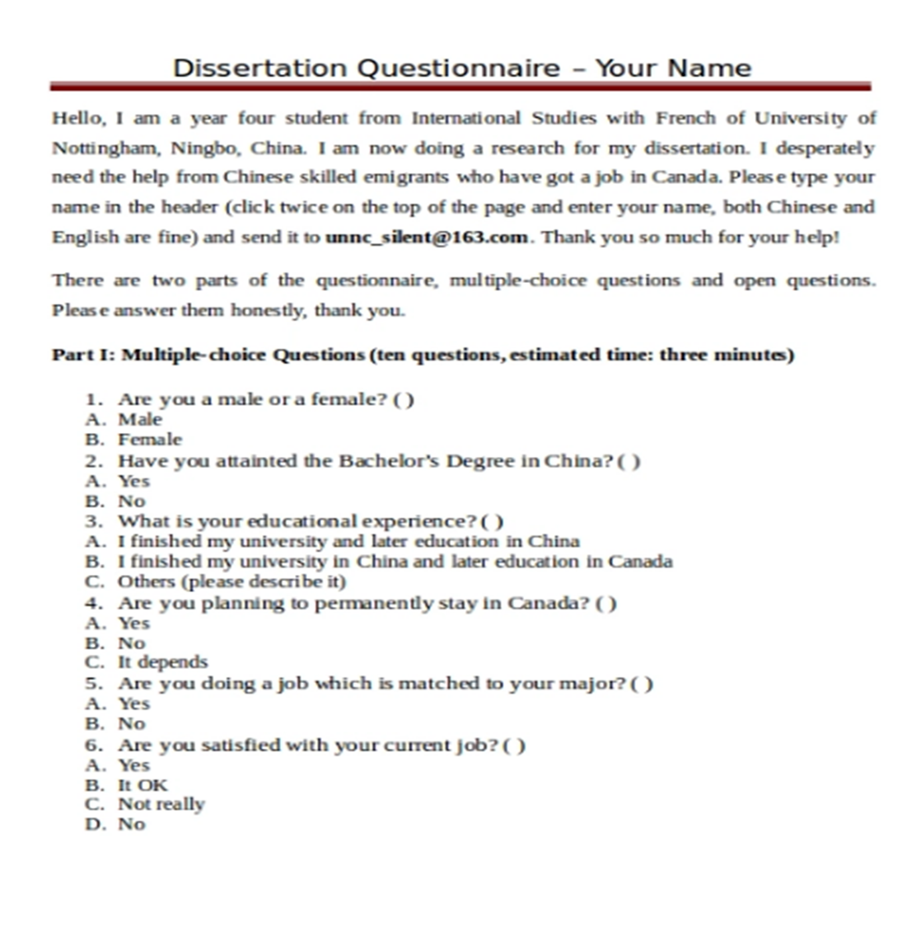
QUESTIONNAIRES

